Slide 1


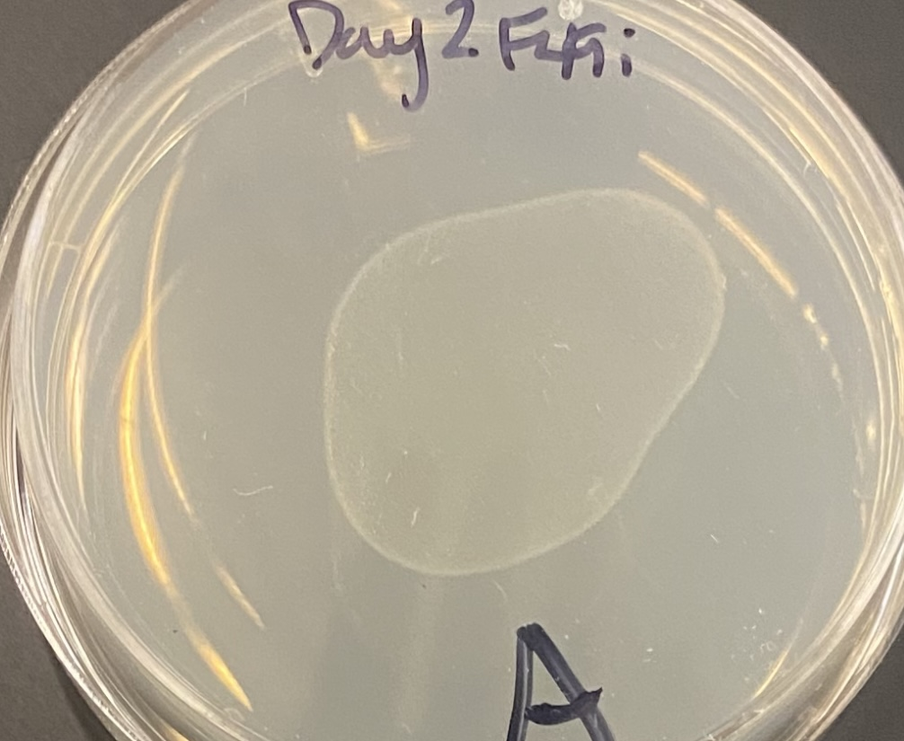
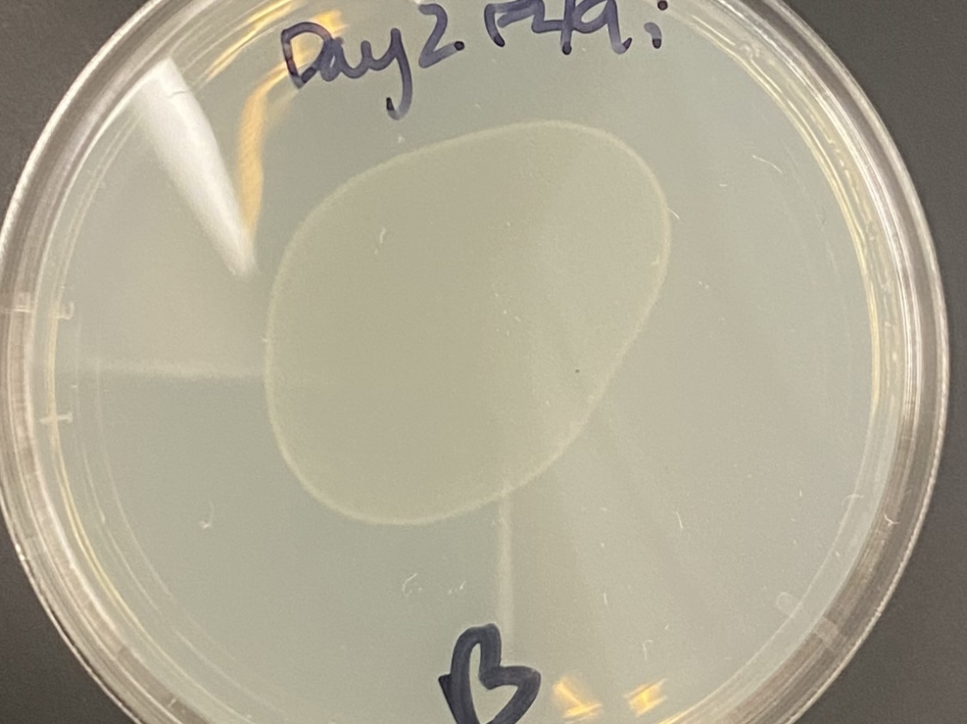
Effects of F49D11.1 Gene Silencing in C. elegans
Sorrel Robertson, Samantha Tian, & Jaime Mohammed
Faculty Sponsor: Jacqueline Gapinski (Ph.D.) | Bellevue College, Department of Molecular Biosciences
ABSTRACT
INTRODUCTION
METHODS
C. elegans is a model organism commonly used in the study of human diseases and genetics. In this experiment ribonucleic acid interference (RNAi) will be induced in C. elegans by feeding to determine embryonic lethality of a gene of choice. RNAi refers to a cellular process in which different RNA molecules are utilized to silence selected genes, without altering the DNA. The gene of choice was F49D11.1, which encodes for a protein used in mRNA splicing. It is expressed throughout every embryonic developmental stage, the muscle cells, germ line, and neurons. The objective of this study is to investigate the effects of silencing F49D11.1 then determining if the absence of this gene leads to embryonic lethality. After RNAi had concluded and the hatched progeny were scored, it was found that Day 1 plates containing affected worms had a 74.3% lethality rate, just 2% under the average for the positive control. Day 2 plates containing the affected worms had a 100% lethality rate. The results of our investigation were highly conclusive that silencing of F49D11.1 causes embryonic lethality.
Caenorhabditis elegans is a species of small (1mm) free living nematodes that share an urbilaterian ancestor with humans. As a result of gene conservation, the form, function, and genetics of C. elegans tissues are analogous to those in humans (2). This makes the species highly relevant for genetics research and the study of human diseases including cancer, neurodegenerative diseases and developmental syndromes. The objective of this project was to understand how gene expression is controlled using RNAi. A simple nervous system, transparent body, and a three-day life cycle make C. elegans an exceptional model organism for understanding just one of many biological functions regulated by RNAi (1). RNAi evolved to exist naturally as a defense against viruses and for the purpose of gene regulation and can be used in lab to prevent the production of proteins encoded by the F49D11.1 gene. The purpose of this research is to investigate the effects of silencing the F49D11.1 mRNA splicing gene.
Streaking out RNAi clone: streak out RNAi clones on agar plates with tetracycline and ampicillin
Inoculating an Overnight Culture: transfer bacteria into LB broth then shake and incubate overnight at 37° C
Plasmid Purification: alkaline lysis procedure with the E. coli plasmid DNA
Gel Electrophoresis: run an agarose gel with the plasmid DNA to determine quality, quantity, and size
Sequence Analysis: review the DNA sequence file of the plasmid DNA using Basic Local Alignment Search Tool (BLAST) to confirm the quality and identity of the DNA sequence
RNAi by Feeding: pick 3-4 L4 worms to two agar plates (Day 1 plate and Day 2 plate) with bacteria that contain a L4440 plasmid with the F49D11.1 gene to ingest its’ dsRNA which will induce RNAi
Control Plates: Set up a negative (SMD1) and positive (Y18D10A.20) control plate
Scoring the Progeny: count the unhatched eggs and L1 worms then calculate the viability of each plate
  When the expression of a certain gene is suppressed, the function of that gene can be observed if there are differences in the experimental C. elegans plates vs. the negative control plate
RESULTS
As expected, Day 1 negative control displayed a high viability and low lethality. Day 2 positive control was not as lethal as expected. Day 1 F49D11.1 silenced progeny had viability and lethality comparable to the positive control. Out of all plates, Day 2 F49 silenced progeny had the least viability with many unhatched eggs and a high lethality rate.
REFERENCES
1. Jnimon. (2013, November 13). Model organisms: Shining examples for simple, effective biology research. NASA. Retrieved December 10, 2021, from https://blogs.nasa.gov/ISS_Science_Blog/2013/11/13/model-organisms-shining-examples-for-simple-effective-biology-research/.
2. Lundquist, E. A. (n.d.). What is C. elegans and why do scientists use it to study human development and disease? Why study C. elegans? Retrieved December 10, 2021, from http://www.people.ku.edu/~erikl/Lundquist_Lab/Why_study_C._elegans.html.
Figure 1. Day 2 plates with F49D11.1 worms (Plates A & B)
DISCUSSION
Figure 2. Graphed embryonic viability and lethality of negative, positive, and F49 RNAi.
Since the negative control had a low embryonic lethality and the positive control had a high embryonic lethality, we can conclude that both controls worked as they were supposed to. When the experimental F49D11.1 gene was knocked down in the worms, there was a high embryonic lethality comparable to the rates of the positive control. Based on the data, it can be concluded that the F49D11.1 gene had a functional effect since its knockdown resulted in embryonic lethality. The implication of this is that the F49D11.1 gene is essential for embryonic viability and development. Some limitations of this experiment included time constraints due to limited lab time as well as deviation between the researchers' accuracy of scoring the progeny.

